Slide 1
Weekly Meeting
Jan 12, 2022
Gwangwoo Kim

Slide 2
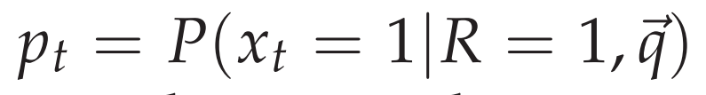
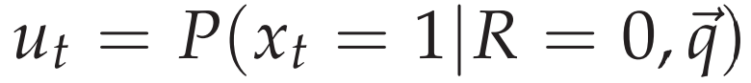
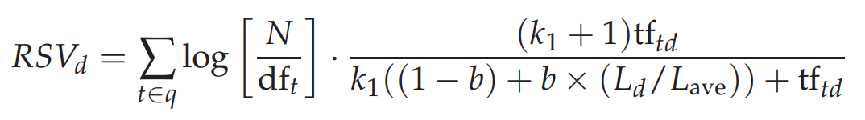
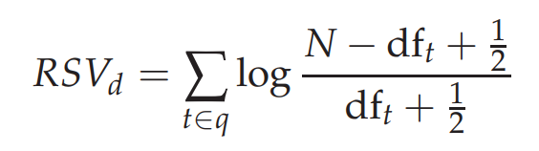
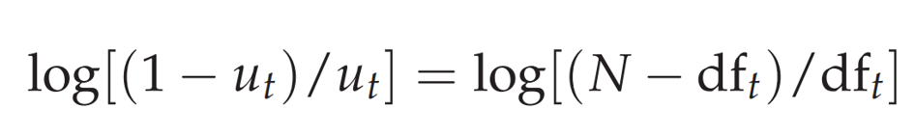
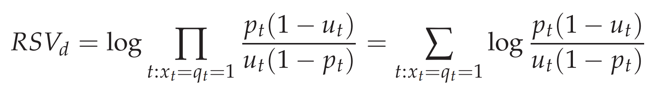
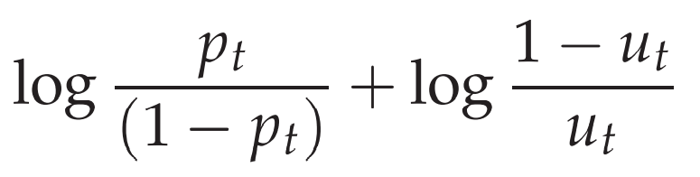
smoothing

Slide 3
For fixed q(=one word) and d
u =
t =
$$p_{t}=\exp\left(u(t−1\right)/(1+exp⁡(u(t−1))$$

Slide 4
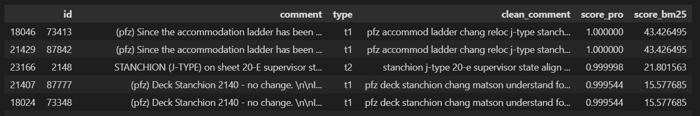
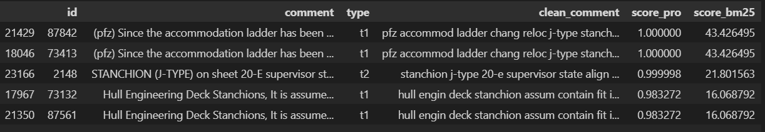

Slide 5
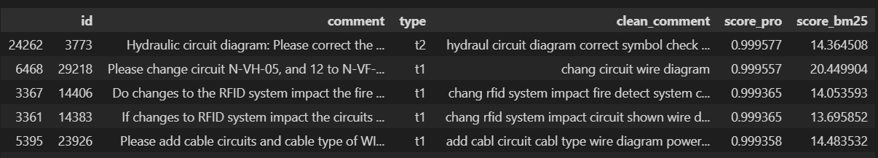
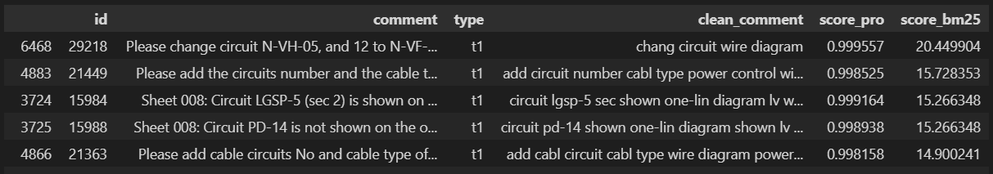

Slide 6
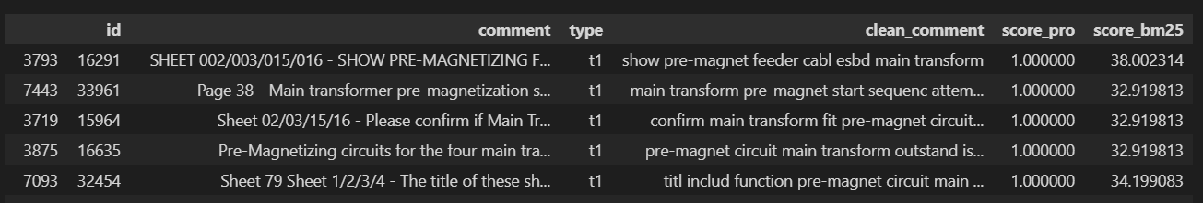
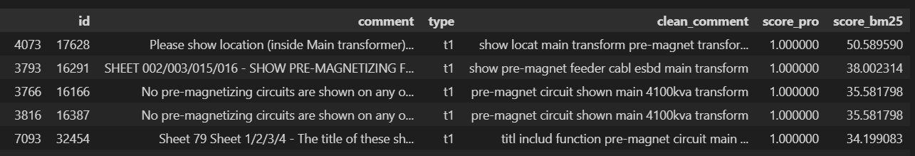

Slide 7
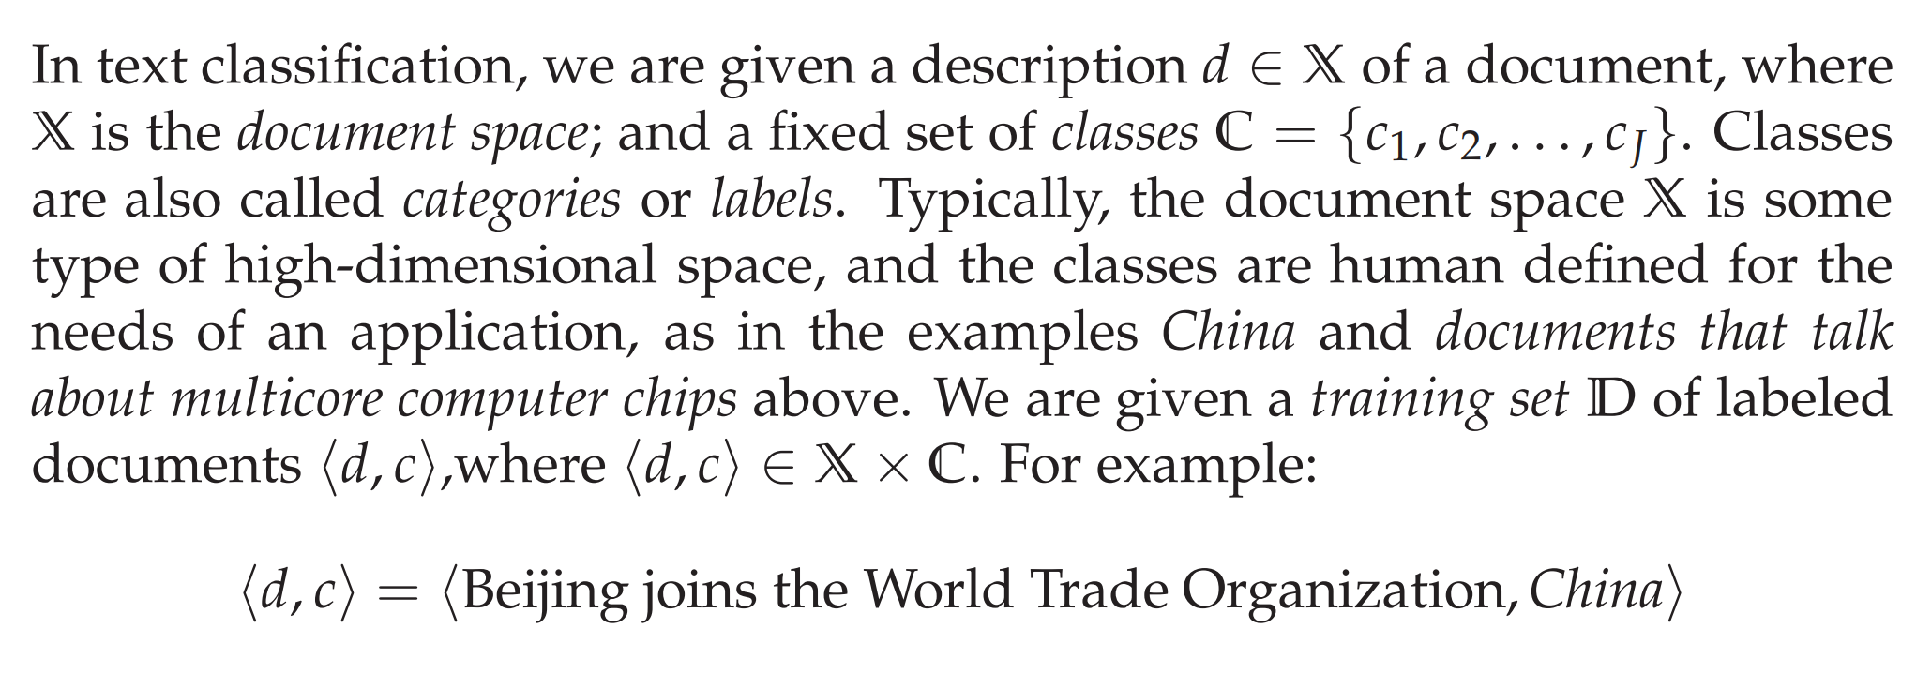
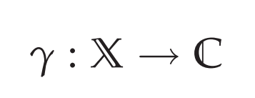
13.1 The text classification problem

Slide 8
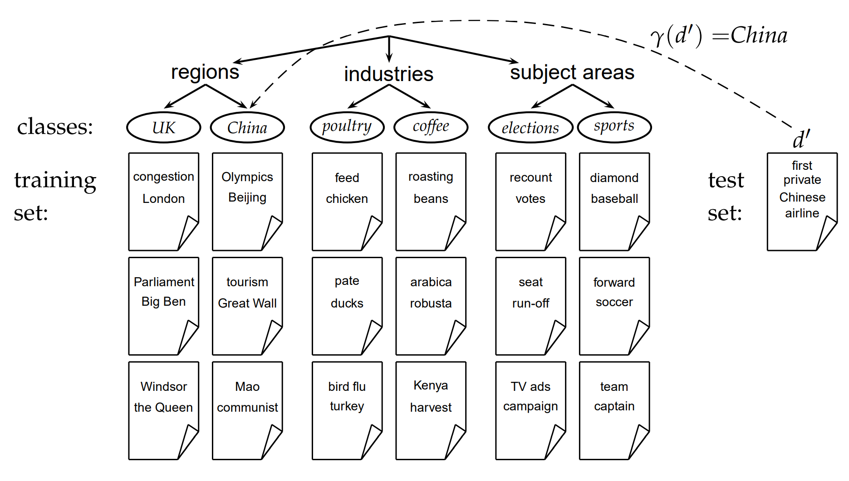
13.1 The text classification problem

Slide 9
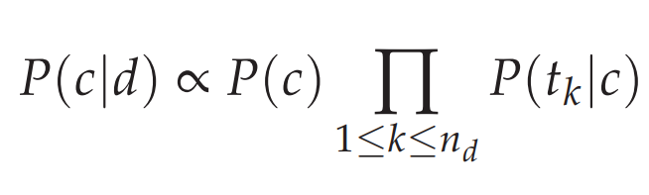
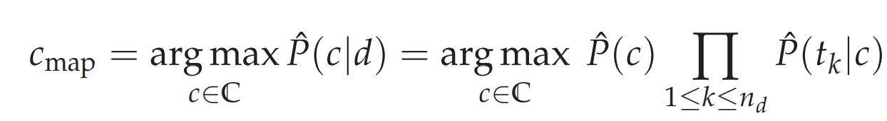
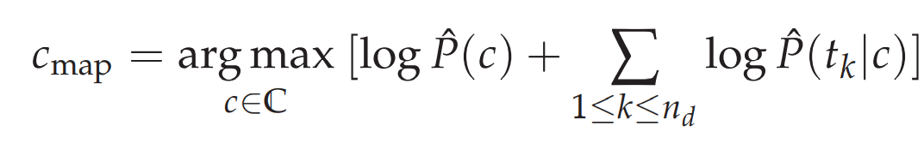
13.2 Naive Bayes text classification
Maximum A Posteriori

Slide 10
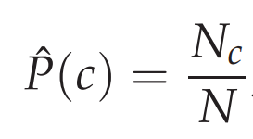
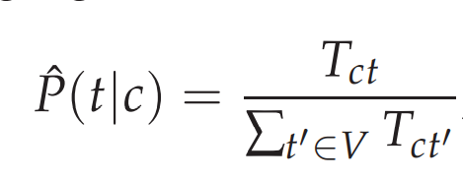
13.2 Naive Bayes text classification

Slide 11

13.2 Naive Bayes text classification
<Remarks>
1. We have made the positional independence assumption.
2. The problem with the MLE estimate is that it is zero for a term–class combination that did not occur in the training data. For example,
This sentence can not be labeled by UK, although Britain is highly related to UK.
Britain is a member of the WTO

Slide 12
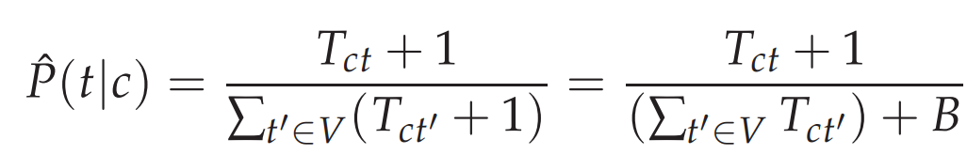
13.2 Naive Bayes text classification
Smoothing
Q: Why do we use V instead of Vc?

Slide 13
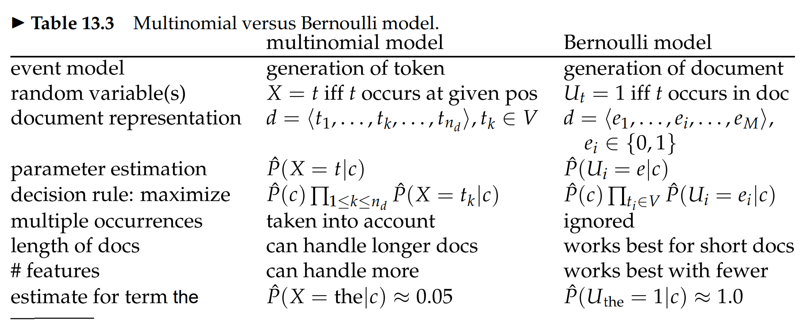
13.3 The Bernoulli model

Slide 14
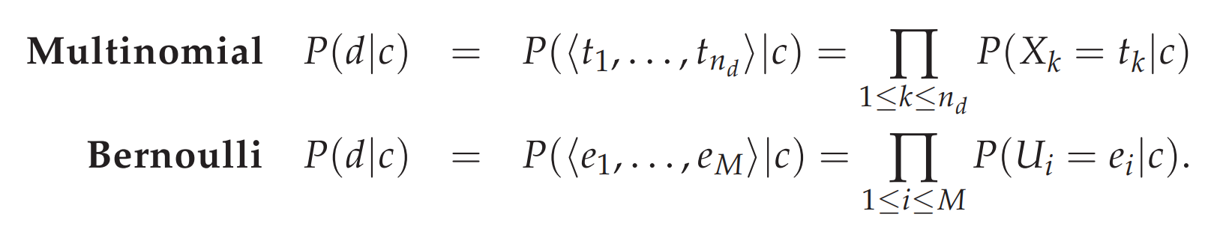
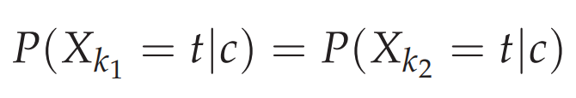
13.4 Properties of Naive Bayes
Conditional independence
Positional independence
Naive Bayes is so called because
the independence assumptions we have just made are indeed very naive for a model of natural language.

Slide 15
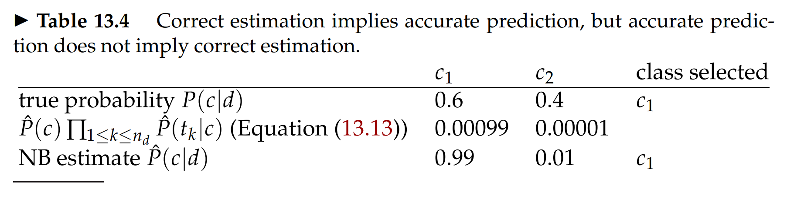
13.4 Properties of Naive Bayes

Slide 16
13.4 Properties of Naive Bayes
<Remarks>
It excels if there are many equally important features that jointly contribute to the classification decision.
It is also somewhat robust to noise features and concept drift.
The Bernoulli model is particularly robust with respect to concept drift.
NB’s main strength is its efficiency:

Slide 17
13.4 Properties of Naive Bayes
<Remarks>
4. NB’s main strength is its efficiency:
4-1. Training and classification can be accomplished with one pass over the data.
4-2. squeezing out a few extra percentage points of accuracy is not worth the trouble in a text classification application
4-3. if its robustness to concept drift can be exploited.
5. The independence assumptions do not hold for text. However, it can be shown that NB is an optimal classifier (in the sense of minimal error rate on new data) for data where the independence assumptions do hold.

Slide 18
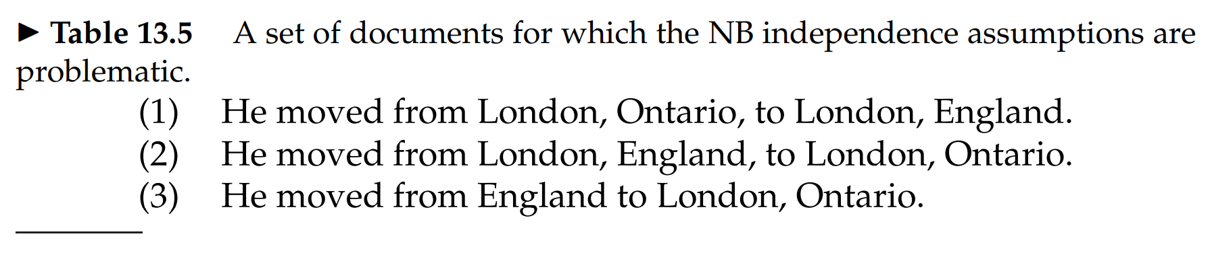
13.4 Properties of Naive Bayes

Slide 19
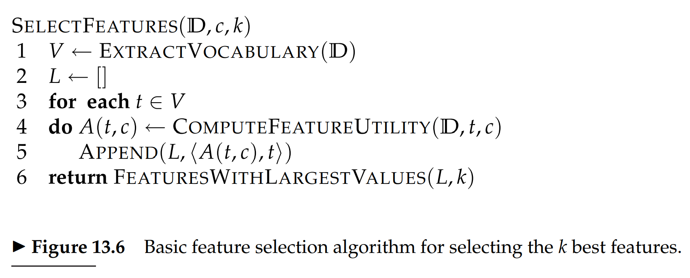
13.5 Feature selection
<Note> the Bernoulli model is particularly sensitive to noise features.

Slide 20
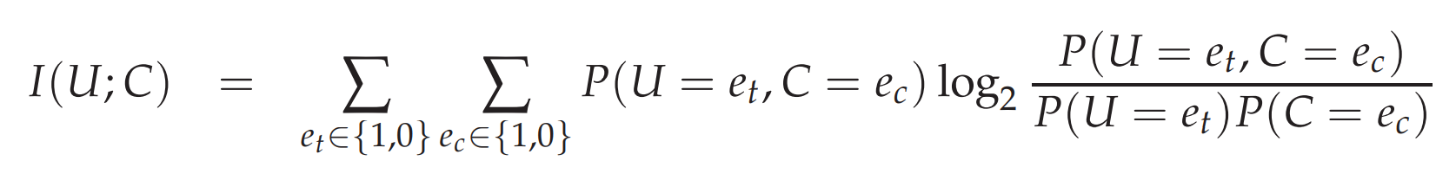
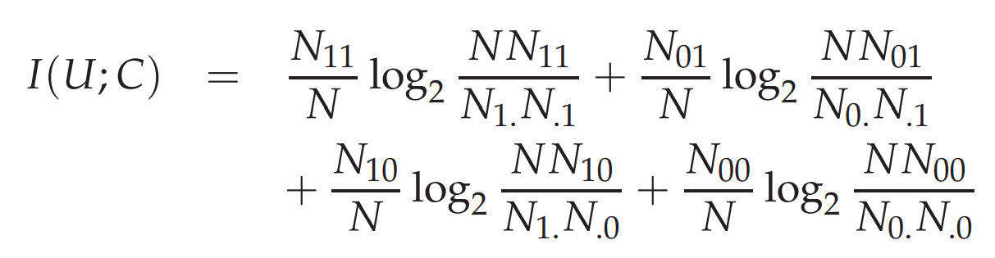
13.5.1 Mutual information
Multi-label
MI measures how much information the presence/absence of a term contributes to making the correct classification decision on c.

Slide 21
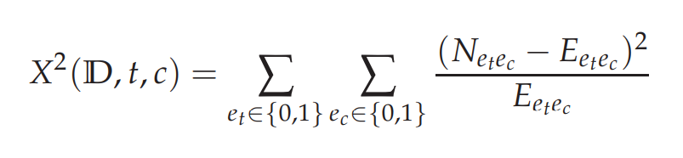
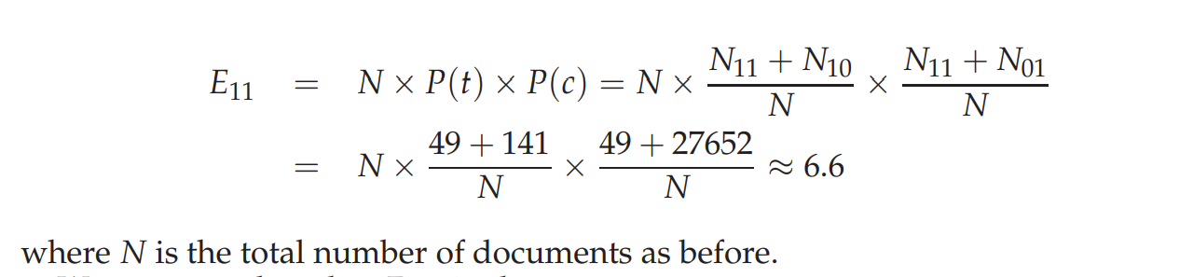
13.5.2 χ 2 Feature selection

Slide 22
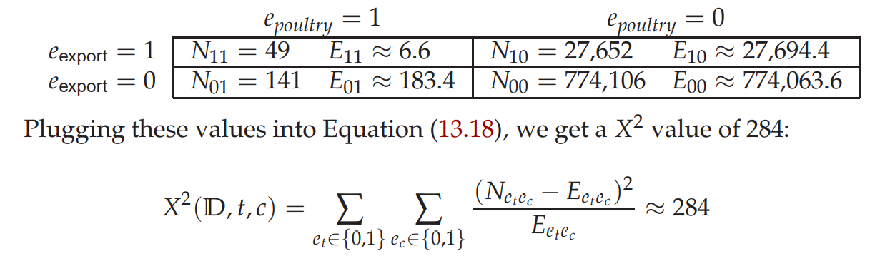
13.5.2 χ 2 Feature selection
This result is statistically significant at the 0.001 level. (284>10.83)
That is, we can reject the independence hypothesis.
If the two events are dependent, then the occurrence of the term makes the occurrence of the class more likely
(or less likely), so it should be helpful as a feature.

Slide 23
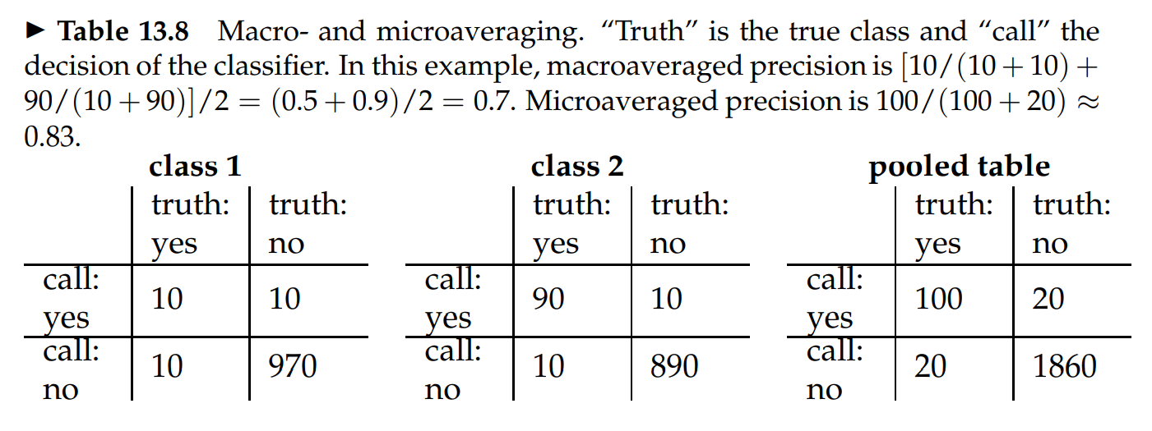
13.6 Evaluation of text classification
Microaveraged results are therefore really a measure of effectiveness on the large classes in a test collection. To get a sense of effectiveness on small classes, you should compute macroaveraged results.

Slide 24
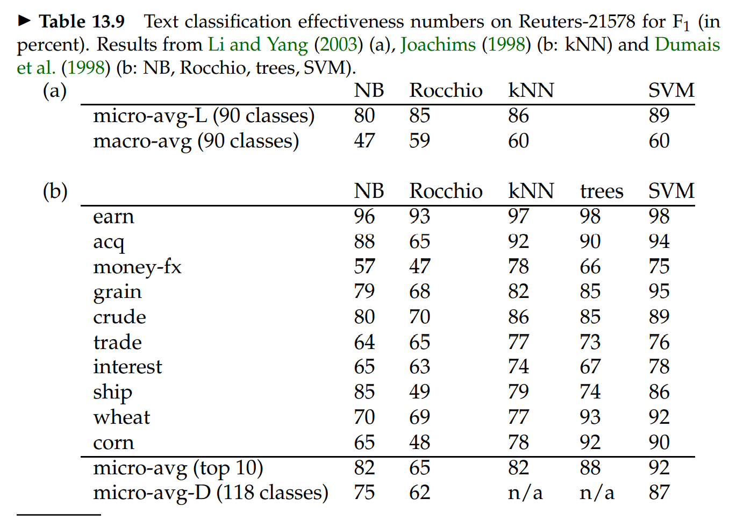
13.6 Evaluation of text classification
In general, NB < kNN < SVM

Slide 25
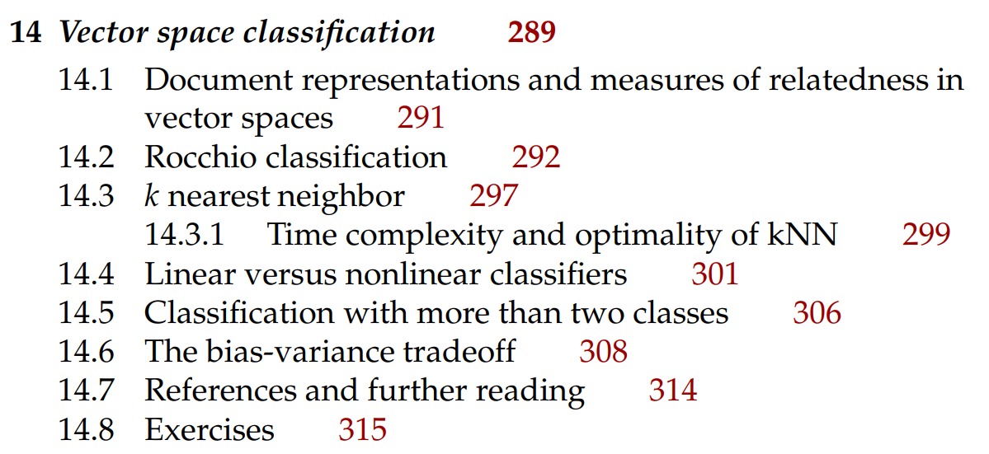
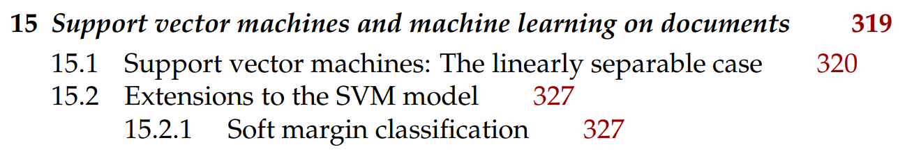
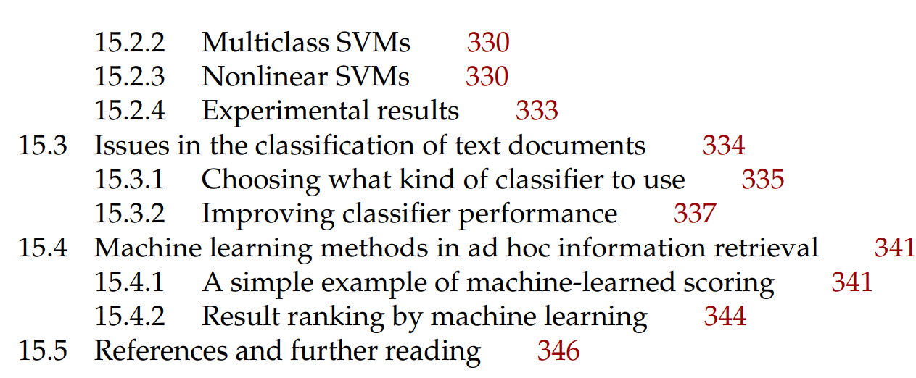
Next

